Slide 1

Async JAVASCRIPT
Itera ukraine 2017
@alSkachkov
Oleksandr SKACHKOV

Slide 2

Async Javascript Journey from callback to async generator
callbacks
promises
async function
async generator

Slide 3
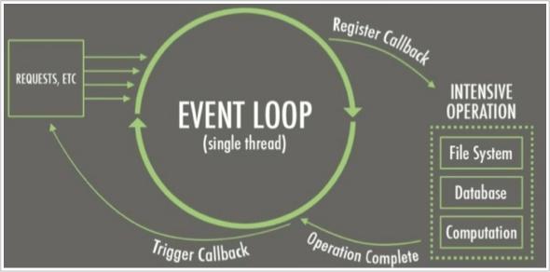
Async JavaScript
Is JavaScript really async?
JavaScript as language was sync until ES6
What about: Event Loop, setTimeout, events and etc?
It is part of the W3C spec
Promise – the first async feature in JavaScript
Notes:
JS работает в асинхронном окружении
https://www.w3.org/TR/html5/webappapis.html#timers
https://www.w3.org/TR/html5/webappapis.html#event-loops
Streams
https://streams.spec.whatwg.org

Slide 4
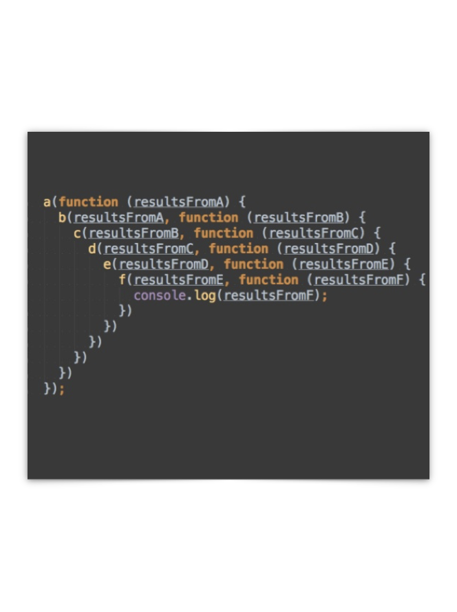
In the beginning was the Function
Callback function
is a function that is passed to another function as a parameter
Problem with using callback
synchronization
callback hell
not clear flow
Notes:
Piramide of The DOOM

Slide 5

Promises in computer science
Promise – 1976
Promise pipeline – 1988
PROMISES
Notes:
Промисы известны с 1976
Барбра Лискова
Марк Симон

Slide 6
TERMS
Future vs Promise vs Deferred:
Future
Promise
Deferred
- is the value
- is the function that sets the value to future
- is an object than can create a promise
Operations of setting value is fulfill or resolve promise

Slide 7
Promises
Analogs in other popular languages
C++ ->std::feature / std:promise
.Net ->Task
Java ->CompletableFuture

Slide 8

Promises in JS
History in JS:
Dojo - Deferred API
Promise/A+ specification
jQuery deferred and Q/$Q
Promises is part of ES6
Notes:
Dojo - 2009
JQuery – 2013 (me)
Q - 2014
ES6 – 2014/2015

Slide 9
Promises in JS
What is Promise in ES6?
The Promise object is used for asynchronous computations. A Promise represents a value which may be available now, or in the future, or never.
Promise’s states:
fulfilled
pending
rejected
Notes:
pending: initial state, not fulfilled or rejected.
fulfilled: meaning that the operation was completed successfully.
rejected: meaning that the operation failed.

Slide 10
Promises in JS
How to create?
new Promise()

Slide 11
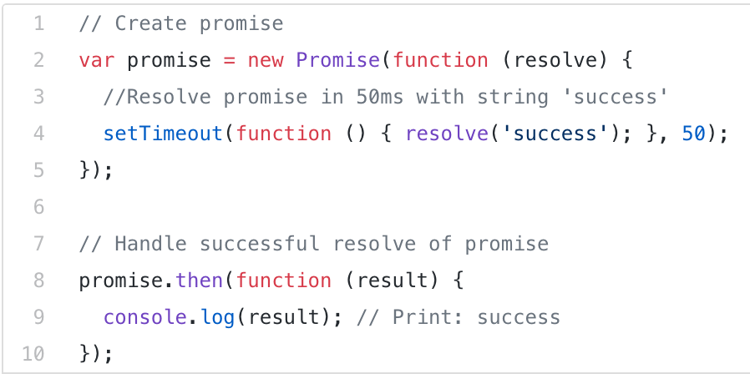
Promises in JS
How to create?
new Promise()

Slide 12
Promises in JS
How to create?
new Promise()

Slide 13
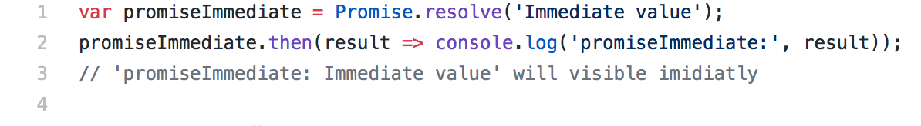
Promises in JS
How to create?
new Promise()
Promise.resolve

Slide 14
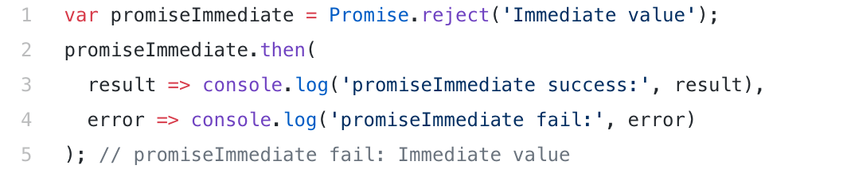
Promises in JS
How to create?
new Promise()
Promise.resolve
Promise.reject

Slide 15
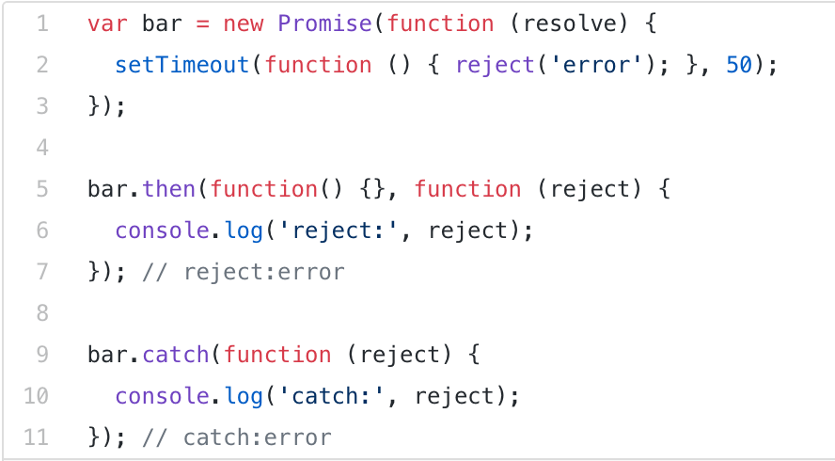
Promises in JS
Promise object has methods:
then
catch

Slide 16
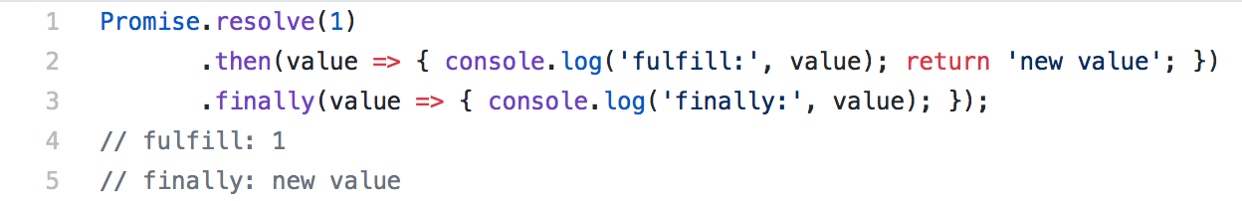
Promises in JS
Promise object has methods:
then
catch
finally - soon

Slide 17
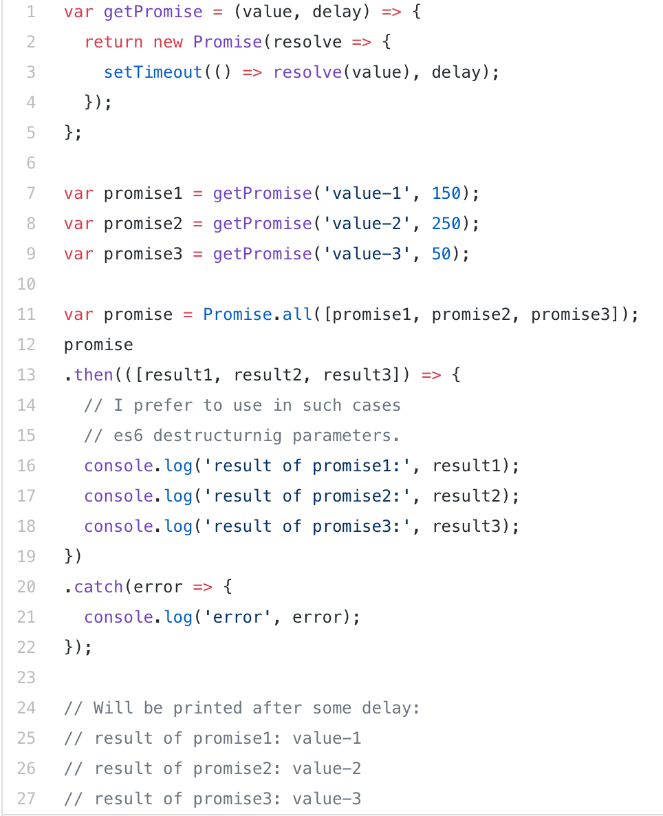
Flow with Promises
Flow with promises:
Promise.all

Slide 18
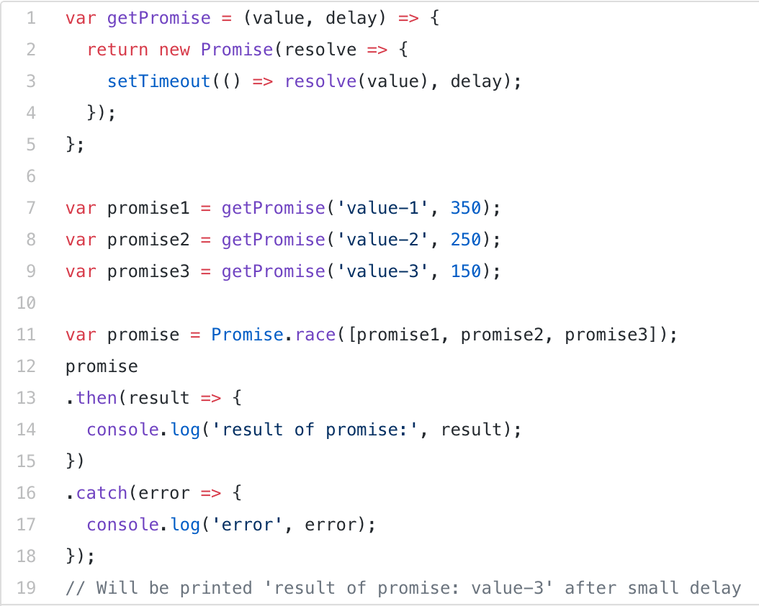
Flow with Promises
Flow with promises:
Promise.all
Promise.race

Slide 19
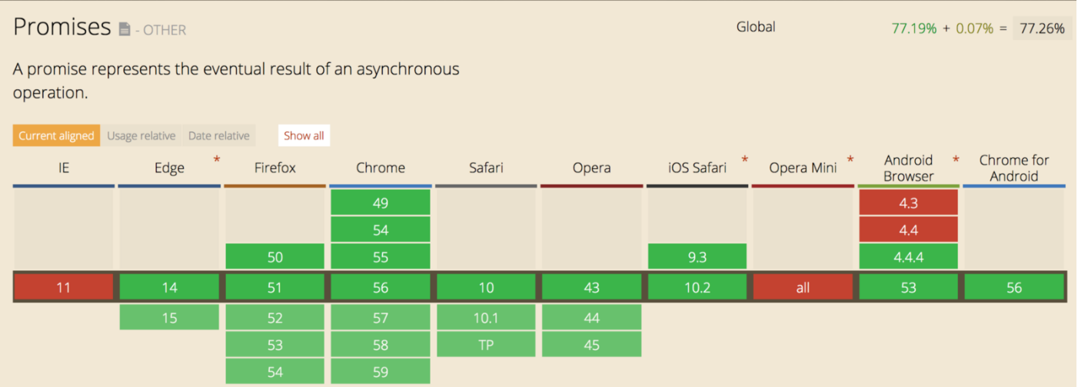
Can we use promise?
Yes we can
Global support 77%
Notes:
http://gs.statcounter.com/
Babel для старых браузеров или полифил

Slide 20
Can We Make Better?
Notes:
Part of the ES2017 Сопрограмма (англ. coroutine) — компонент программы, обобщающий понятие подпрограммы, который дополнительно поддерживает множество входных точек (а не одну, как подпрограмма), остановку и продолжение выполнения с сохранением определённого положения.

Slide 21
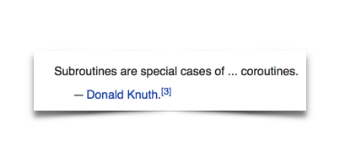
ASYNC FUNCTION
Coroutine – async function
History:
Coroutine is coined by Melvin Conway in 1958
Inspired by C#/F#, started in 2014 by Luke Hoban and finished by Brian Terlson.
Notes:
Part of the ES2017 Сопрограмма (англ. coroutine) — компонент программы, обобщающий понятие подпрограммы, который дополнительно поддерживает множество входных точек (а не одну, как подпрограмма), остановку и продолжение выполнения с сохранением определённого положения.

Slide 22
ASYNC FUNCTION
Analogs
.Net - C# Async function
Java – Spring (directive @Async)
C++ - different approaches on is std::async

Slide 23
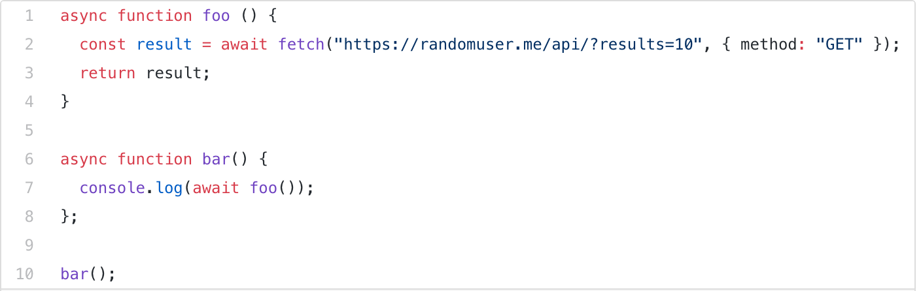
ASYNC FUNCTION
async function
async/await keyword
async function always returns Promise

Slide 24
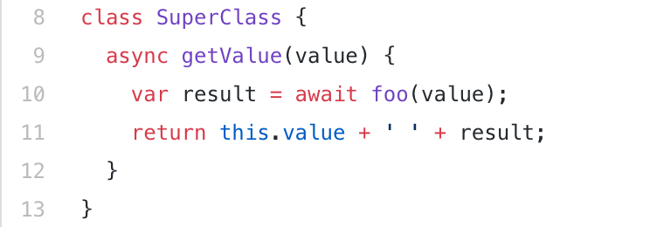
ASYNC FUNCTION
async arrow function
async method in class

Slide 25
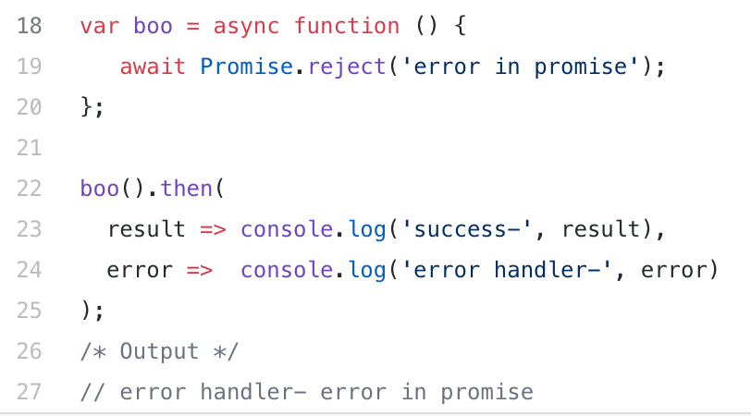
ASYNC FUNCTION
Throw exception in async function
reject in await

Slide 26
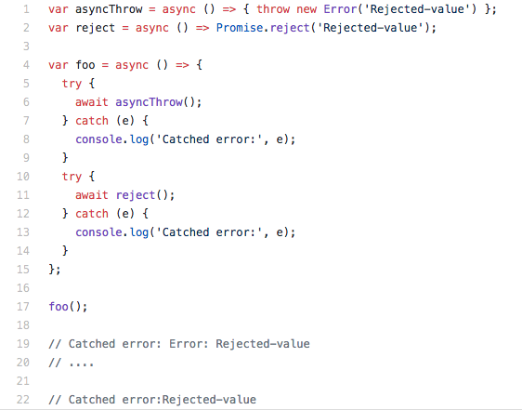
ASYNC FUNCTION
Throw exception in async function
reject in await
can be handled by try/catch

Slide 27
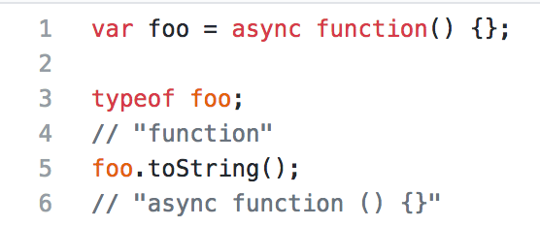
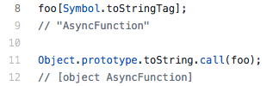
IS Function ASYNC FUNCTION?
typeof or toString?
No
Symbol.toStringTag and Object.prototype.toString.call(…)
Notes:
Symbol.toStringTag is property

Slide 28
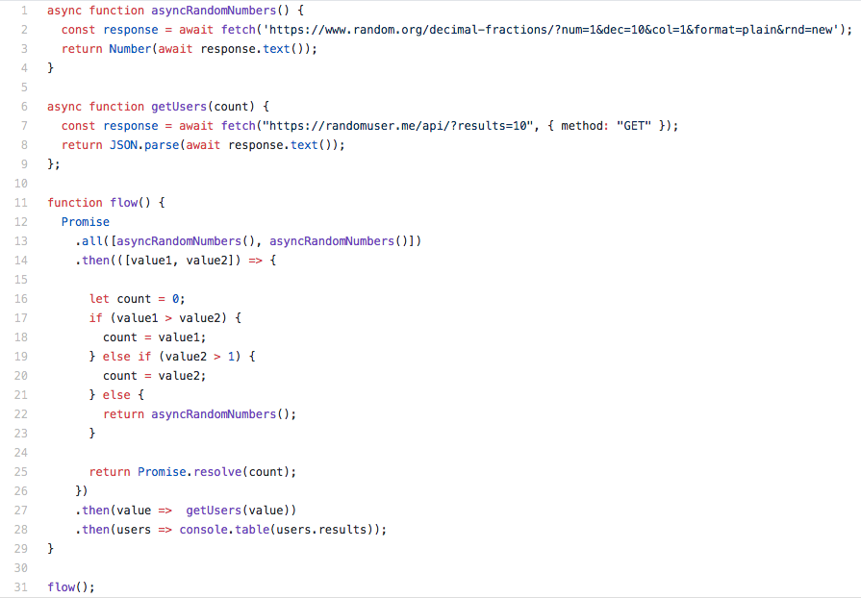
Flow With ASYNC FUNCTION
Promise

Slide 29
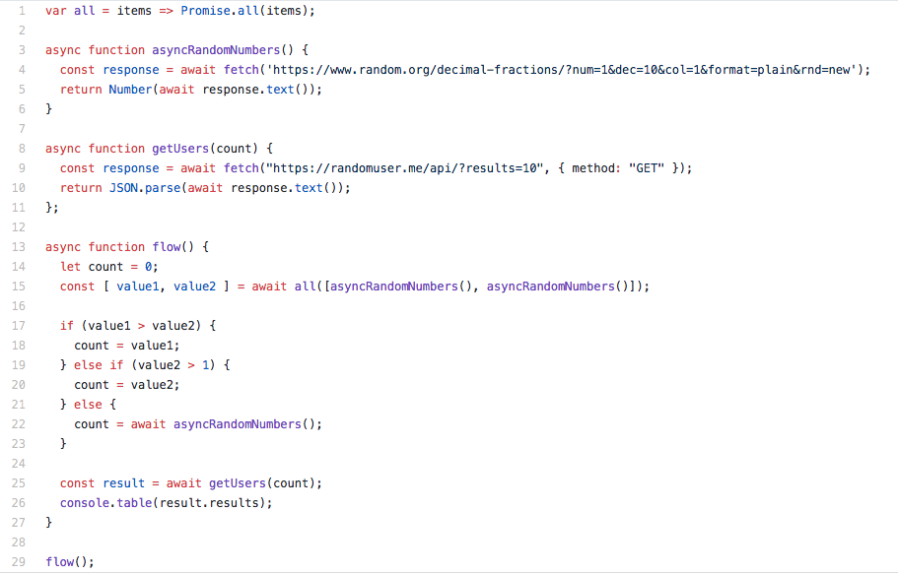
Flow With ASYNC FUNCTION
Promise
Async function

Slide 30
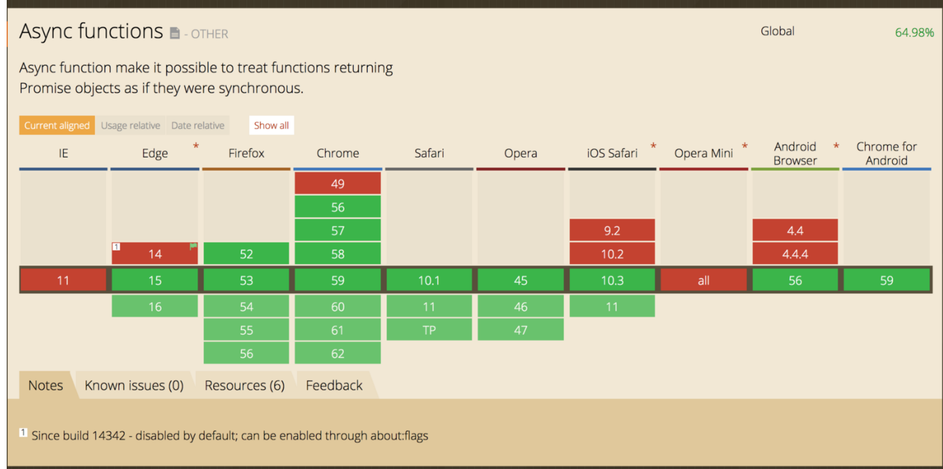
Can we use ASYNC FUNCTION?
Yes we can
Global support 65%
Notes:
https://babeljs.io/repl/#?babili=false&evaluate=true&lineWrap=false&presets=es2015%2Creact%2Cstage-2&targets=&browsers=&builtIns=false&debug=false&code_lz=IYZwngdgxgBAZgV2gFwJYHsL3egFAShgG8AoGGYAd2FWRgHIBGegbjJgCcBTZBDregCZWJAL4kScHARZA

Slide 31
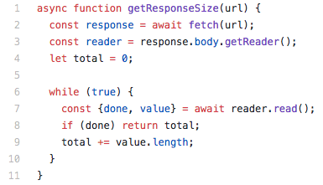
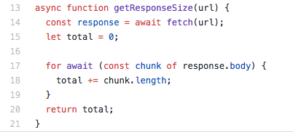
CAN WE MAKE BETTER?

Slide 32
Async Generator
Started developed by Kevin Smith in 2014, and finished by Domenic Denicola in 2017. Currently it is on STAGE - 3
Analogs:
.Net C# - AsyncEnumerator
C++ - Proposals n4244 & N3858(C++17) - Resumable Functions (resume/await)
Java – Not supported

Slide 33
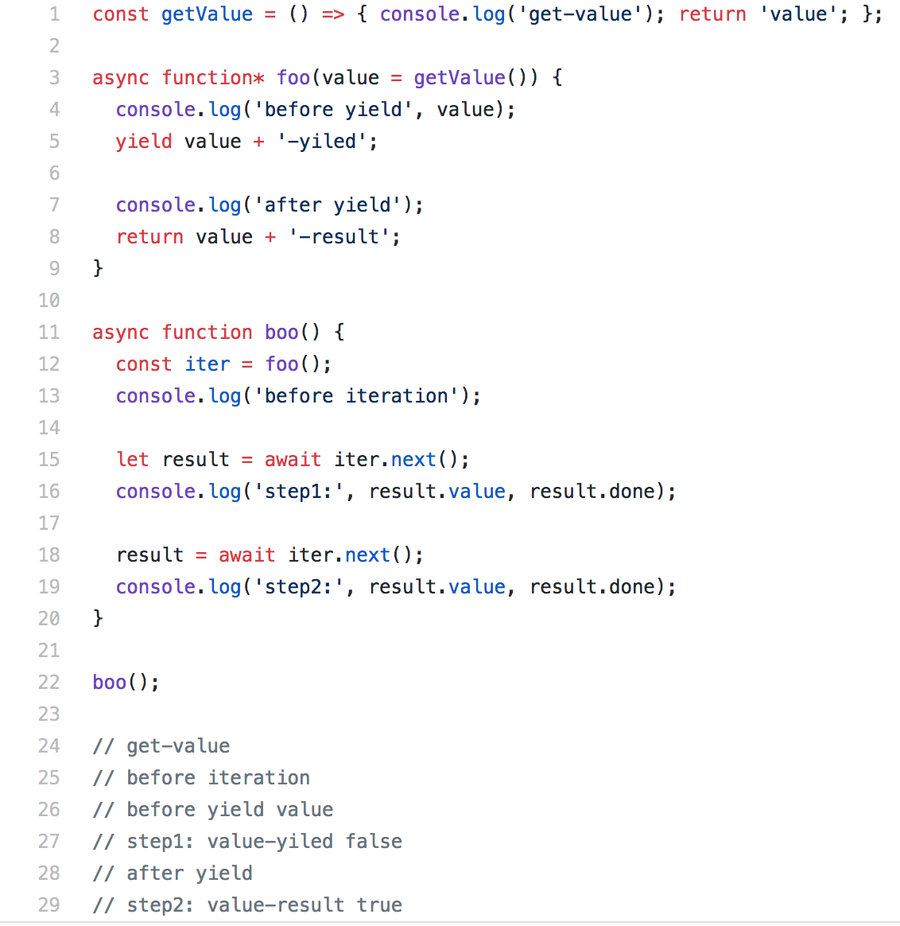
Async Generator. Run TIME
Async generator return iterator object
Async generator does not execute its body immediately

Slide 34
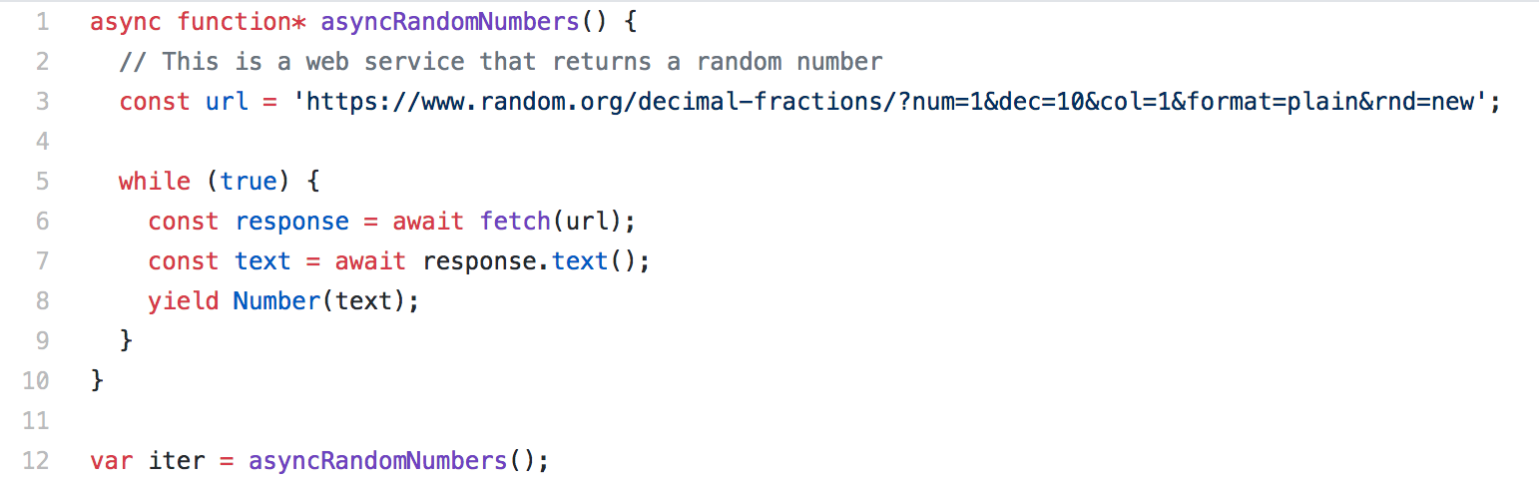
Async Generator
Async generator return iterator
with methods:

Slide 35
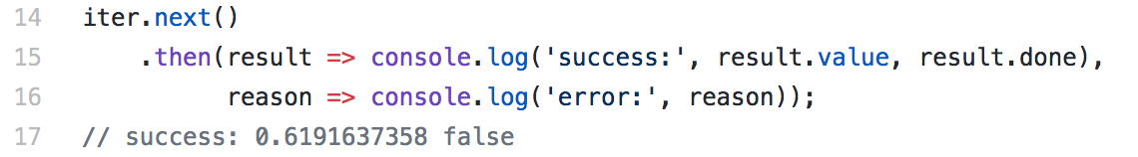
Async Generator
Async generator return iterator
with methods:
next

Slide 36
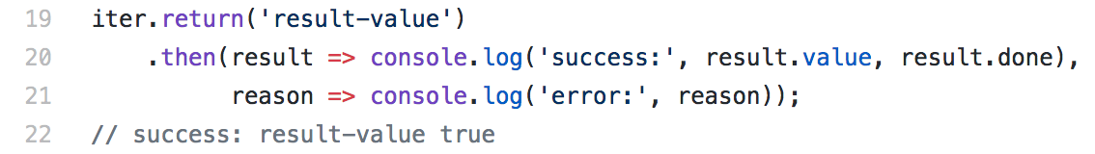
Async Generator
Async generator return iterator
with methods:
next
return

Slide 37
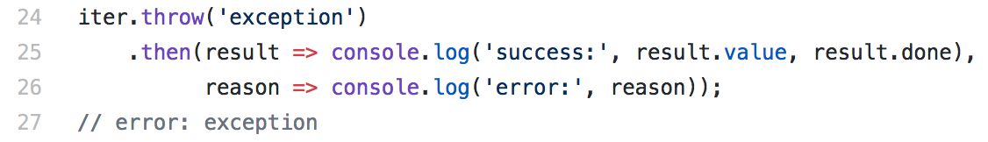
Async Generator
Async generator return iterator
with methods:
next
return
throw

Slide 38
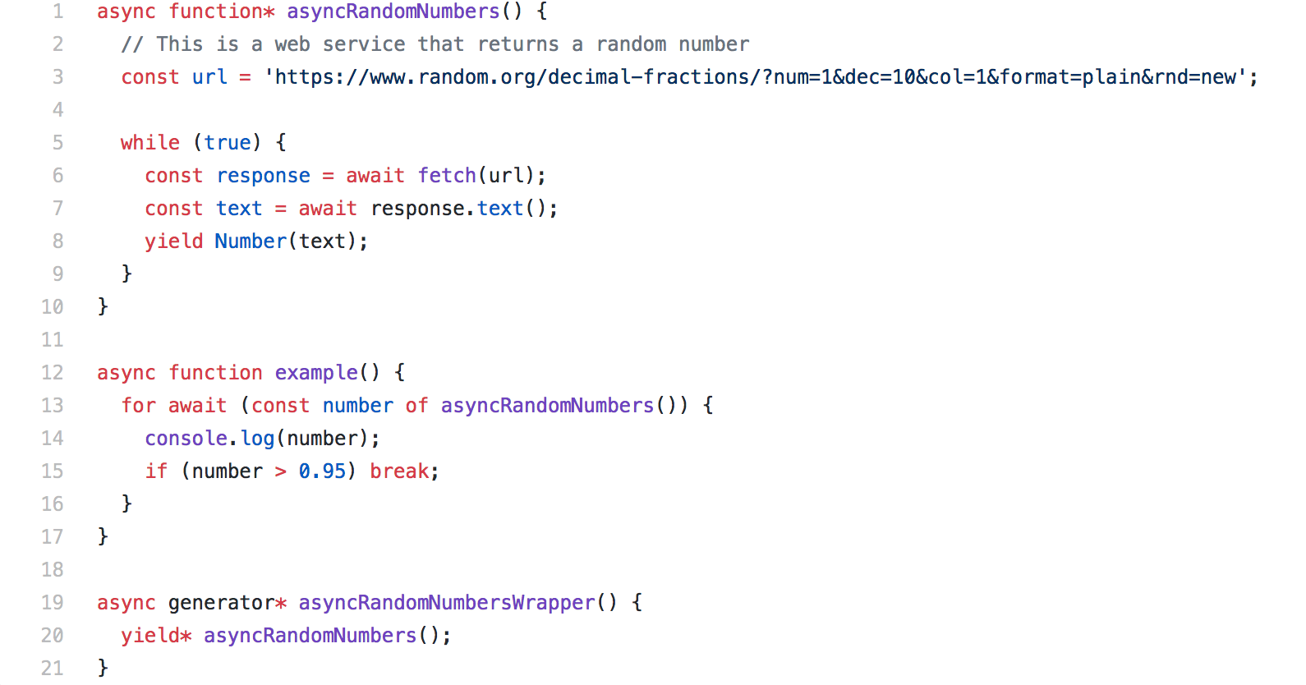
ASYNC GENERATOR
New keywords: for await, yield *

Slide 39
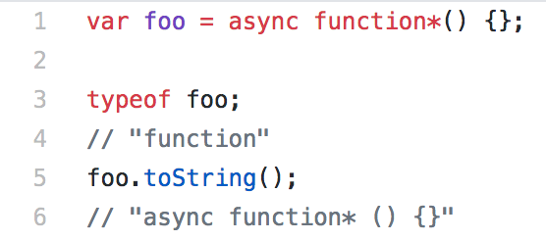
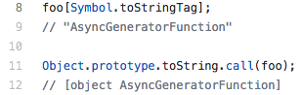
IS Function ASYNC Generator?
typeof or toString?
Symbol.toStringTag and Object.prototype.toString.call(…)
Notes:
Symbol.toStringTag is property

Slide 40

Can we use ASYNC GENERATOR?
Not, but:
only in Chrome Canary with --js-flags=--harmony-async-iteration

Slide 41

Can we use ASYNC GENERATOR?
Not, but:
only in Chrome Canary with --js-flags=--harmony-async-iteration
my MacBook

Slide 42
Question?

Slide 43


